Slide 1
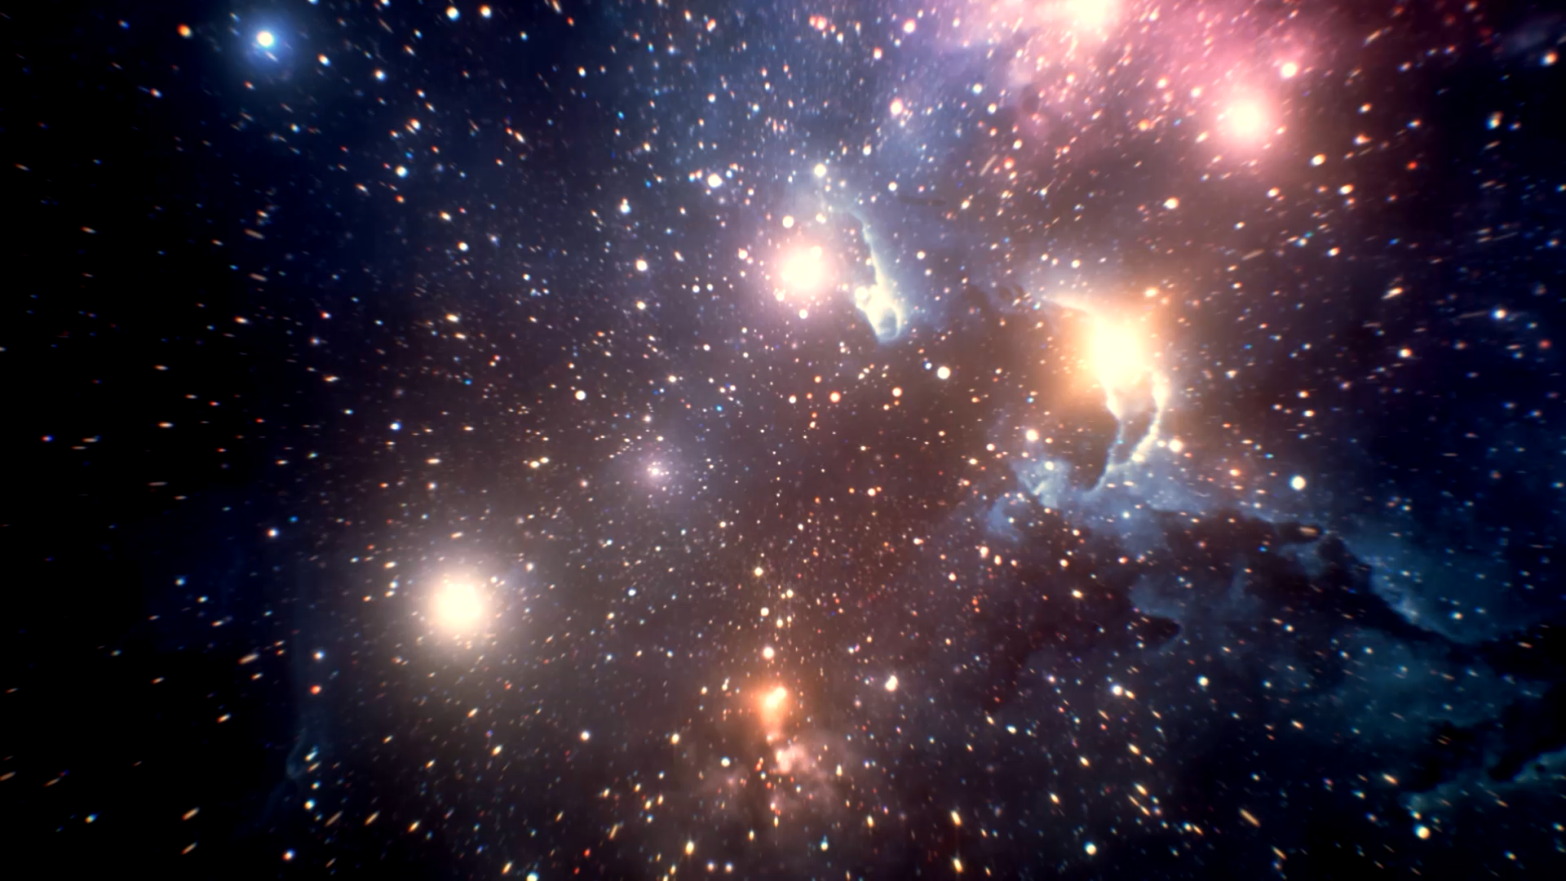
Atoms and Light
The Universe
IS #6

Slide 2
Lecture Recap
What is one thing you remember from the lecture?

Slide 3
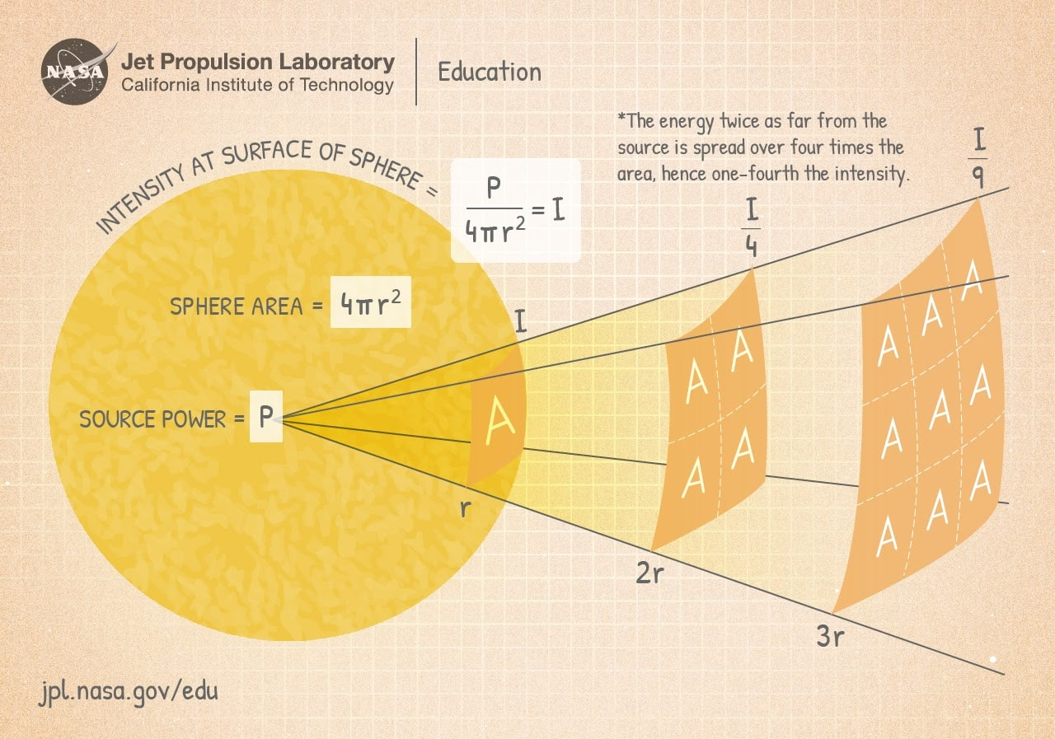

Inverse Square Law and Magnitudes of Brightness

Slide 4
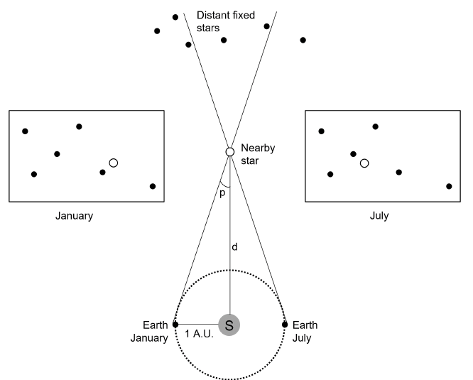
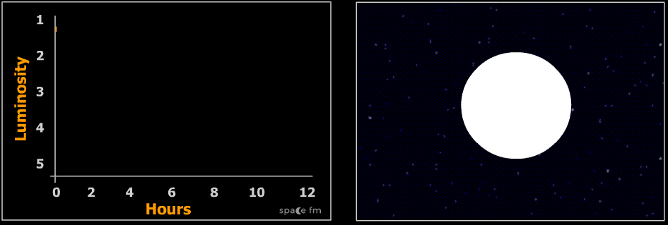
Stellar Parallax and Cepheid Variables

Slide 5
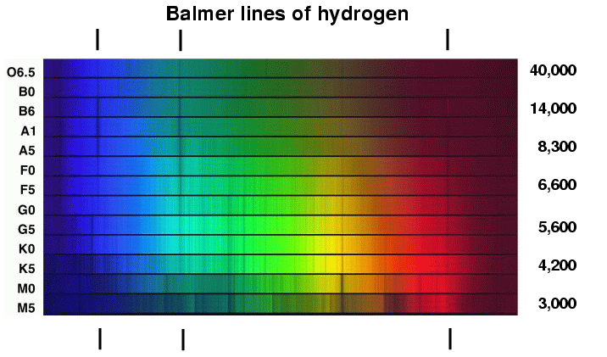
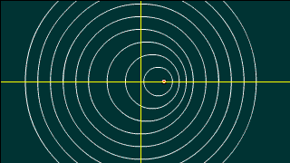
Stellar Classification and Doppler Shift

Slide 6


In-class Activity #1
Estimate the power of the sun with an incandescent bulb and your thermoreception!
$$I∝\frac{1}{d^{2}}$$
Student | Distance (m)
#1
#2
… | …

Slide 7



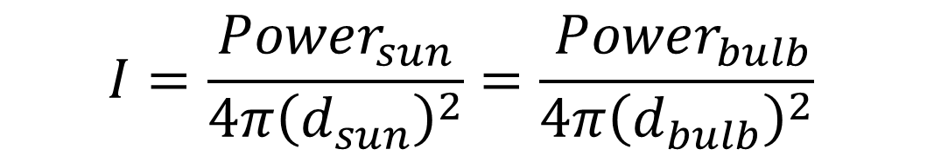
In-class Activity #1
$$I=\frac{Power_{sun}}{4π{\left(d_{sun}\right)}^{2}}=\frac{ Power_{bulb}}{4π{\left(d_{bulb}\right)}^{2}}$$
1 AU
$$What is d_{sun}?$$

Slide 8
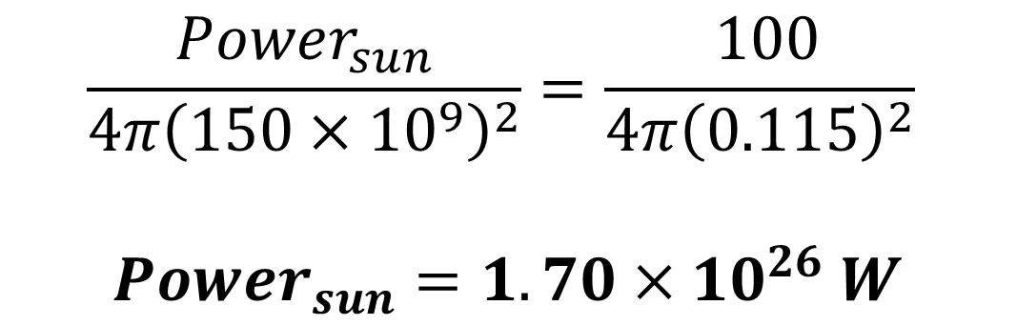
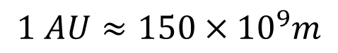
In-class Activity #1
$$I=\frac{Power_{sun}}{4π{\left(d_{sun}\right)}^{2}}=\frac{ Power_{bulb}}{4π{\left(d_{bulb}\right)}^{2}}$$
1 AU
$$Using d_{bulb}=0.115m and Power_{bulb}=100W,$$
$$\frac{Power_{sun}}{4π{\left(150×{10}^{9}\right)}^{2}}=\frac{ 100}{4π{\left(0.115\right)}^{2}}$$ $Power_{sun}=1.70×{10}^{26} W$
$$1 AU≈150×{10}^{9}m$$
Power of sun = $3.828×{10}^{26}$ (Williams D.R., 2013)

Slide 9


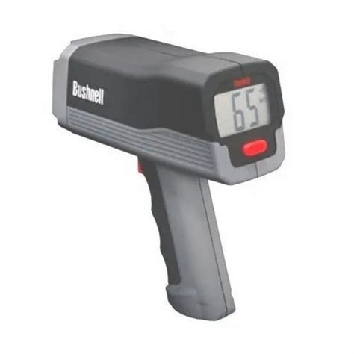
In-class Activity #2
Understanding the Doppler Effect:
A change in frequency/wavelength of a wave detected due to relative motion between wave source and observer.
λ
λ'
Can this affect other kinds of waves?
Yes! Its applications include:
Astrospectroscopy
Traffic regulation etc.

Slide 10

Discussion Questions

Slide 11
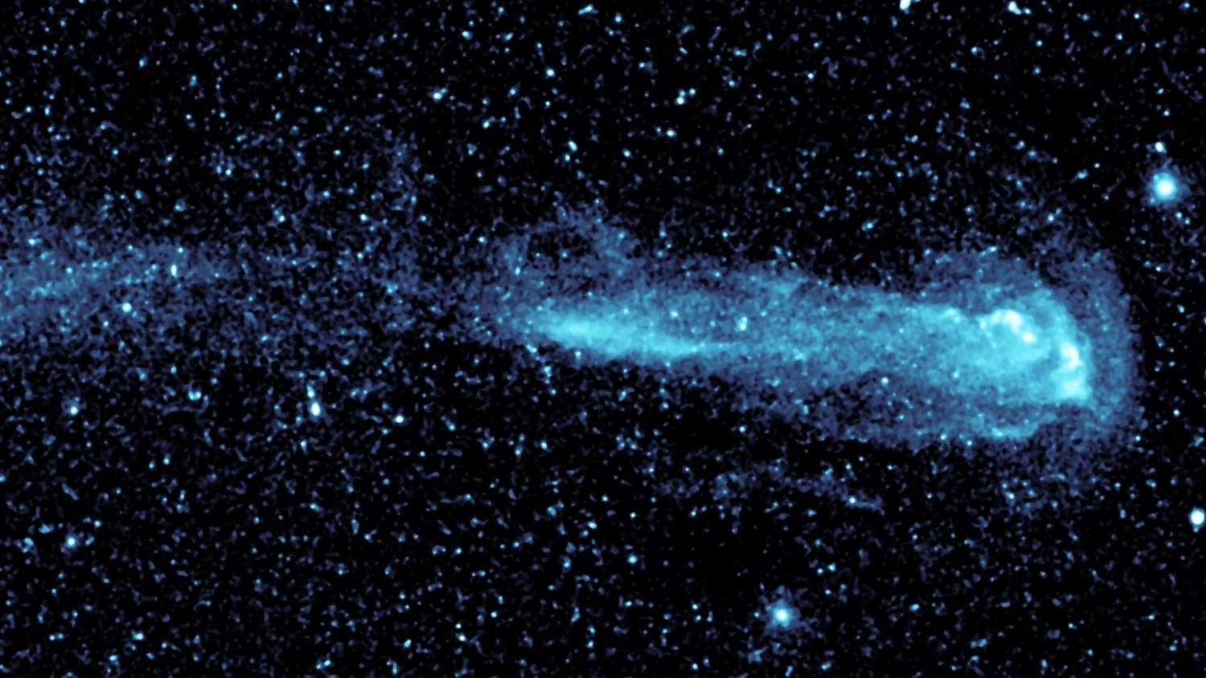
Q2
Assuming Mira is 100 parsecs away, calculate its absolute magnitude at its brightest and dimmest.
In terms of luminosity, how much brighter or dimmer is Mira compared to our Sun?

Slide 12
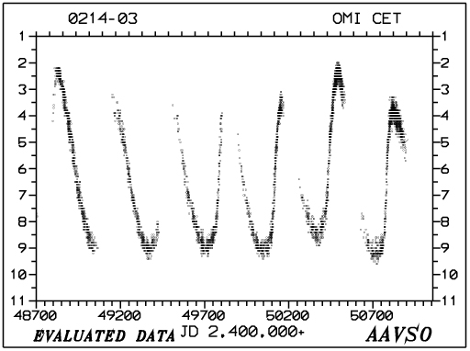
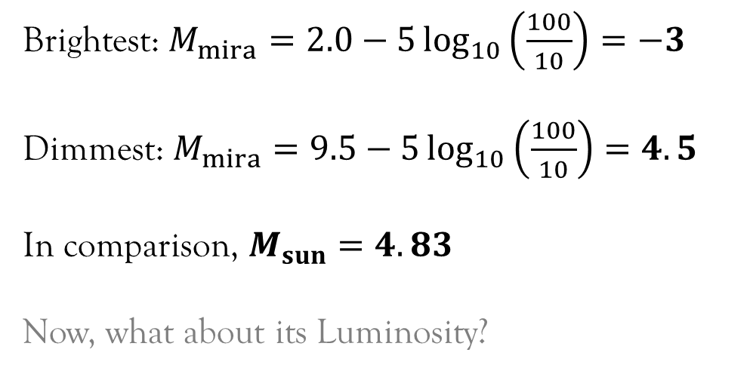
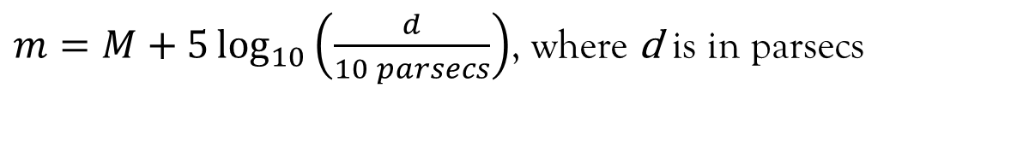
Q2 Calculate Mira’s absolute magnitude at its brightest and dimmest
Using Equation 5.1,
$m=M+5\log_{10}\left(\frac{d}{10 parsecs}\right)$, where d is in parsecs
Given $d = 100$ parsecs. From AAVSO, $m_{mira}=2.0$ (brightest) or 9.5 (dimmest).
Brightest: $M_{mira}=2.0−5\log_{10}\left(\frac{100}{10}\right)=−3$
Dimmest: $M_{mira}=9.5−5\log_{10}\left(\frac{100}{10}\right)=4.5$
In comparison, $M_{sun}=4.83$
Now, what about its Luminosity?
https://www.aavso.org/vsots_mira

Slide 13
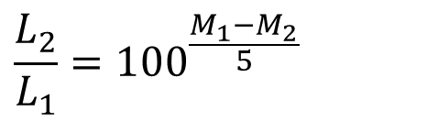

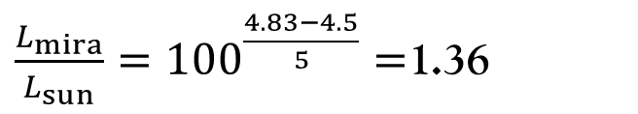
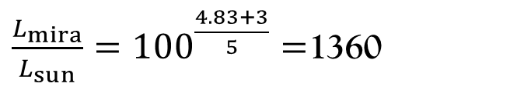
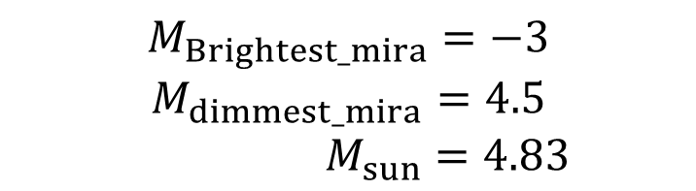
Q2
$$M_{Brightest_mira}=−3$$
$$M_{dimmest_mira}=4.5$$
$$M_{sun}=4.83$$
$$F =\frac{L}{4πd^{2}} and \frac{F_{2}}{F_{1}}={100}^{{(m}_{1}−m_{2})/5 }$$
To compare the Luminosity, we place the 2 stars at the same distance (10pc)
$$\frac{L_{2}}{L_{1}}=100^{\frac{M_{1}−M_{2}}{5}}$$
$\frac{L_{mira}}{L_{sun}}=100^{\frac{4.83+3}{5}}=$1360
When Mira is brightest,
$\frac{L_{mira}}{L_{sun}}=100^{\frac{4.83−4.5}{5}}=$1.36
When Mira is dimmest,

Slide 14
Q2
“Mira is plunging through our part of the Milky way with an unusually large space velocity, 130 km/s.” Is this velocity in the radial or tangential direction?

Slide 15
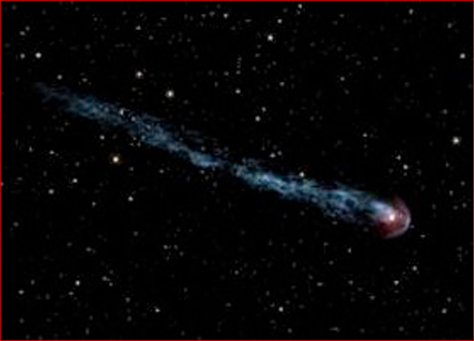

Q2 Is Mira’s velocity in the radial or tangential direction?
Tangential direction
The fact we can see a ‘tail’ tells us that Mira is NOT moving purely in a radial direction (directly towards us) but has some component of its velocity in the tangential direction!
Radial direction
!

Slide 16
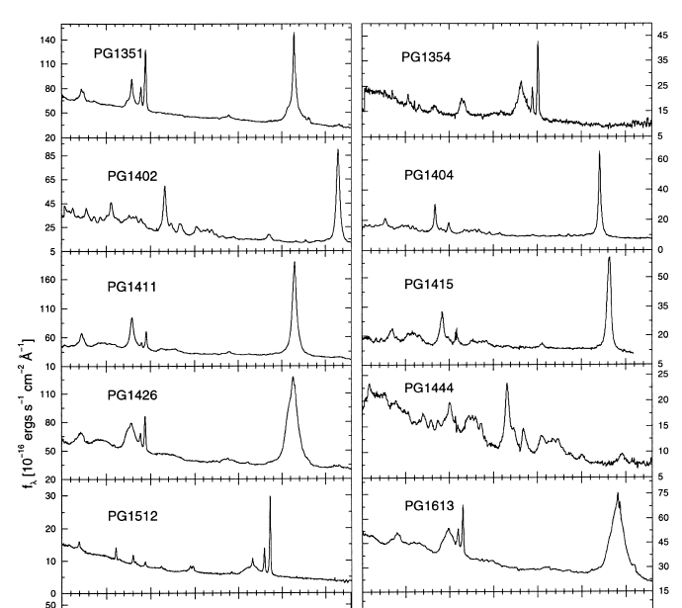
Q3
Discuss the spectrums of PG1351, PG1354 and PG1512
Signature peak wavelengths
PG1351: 5450 angstroms PG1354: 6500 angstroms
PG1512: 6850 angstroms
What spectrum of light is this?
Wavelength (angstroms)

Slide 17
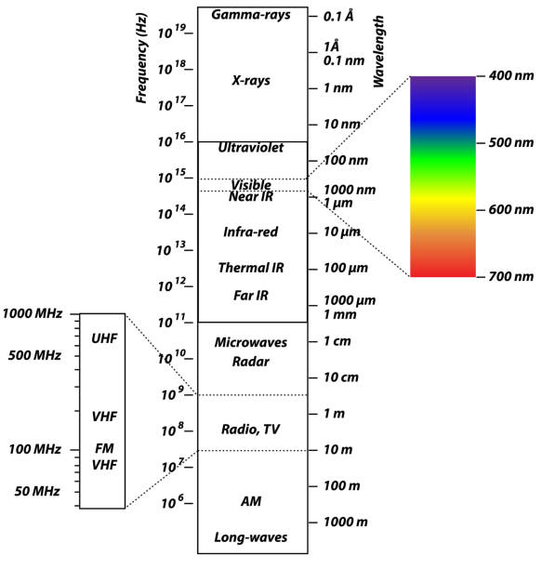
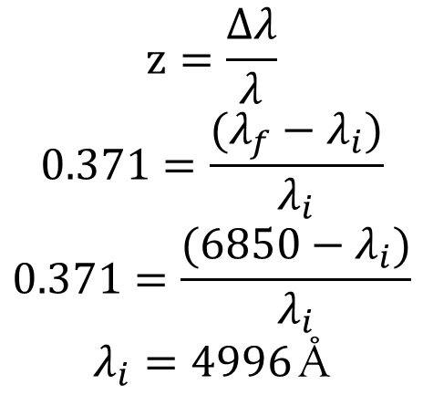
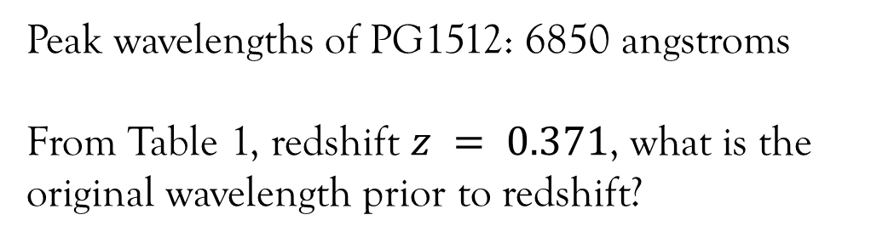
Q3
Peak wavelengths of PG1512: 6850 angstroms From Table 1, redshift $z = 0.371$, what is the original wavelength prior to redshift?
$$z=\frac{Δλ}{λ}$$
$$0.371=\frac{(λ_{f}−λ_{i})}{λ_{i}}$$
$$0.371=\frac{(6850−λ_{i})}{λ_{i}}$$
$λ_{i}=4996$ Å

Slide 18
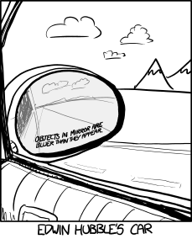
In-class Activity #2
Discuss this comic from xkcd.com

Slide 19
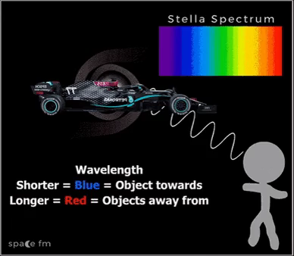
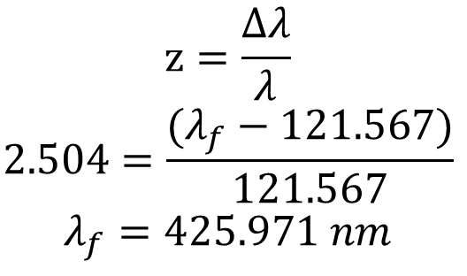
Q4
Given that the recession velocity, z of a particular quasar is 2.504, what is the observed wavelength of the Hydrogen Lyα line (121.567nm) ?
$$z=\frac{Δλ}{λ}$$
$$2.504=\frac{(λ_{f}−121.567)}{121.567}$$
$$λ_{f}=425.971 nm$$
How does the direction of a galaxy’s relative motion affect the observed wavelength of light?
So that’s why Ferraris are red…

Slide 20
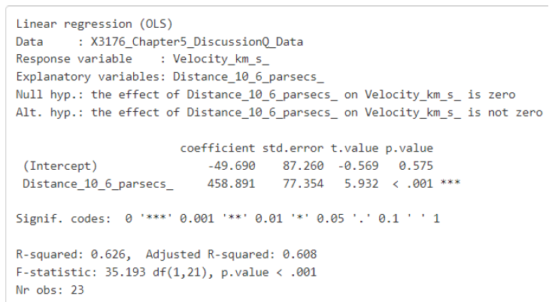
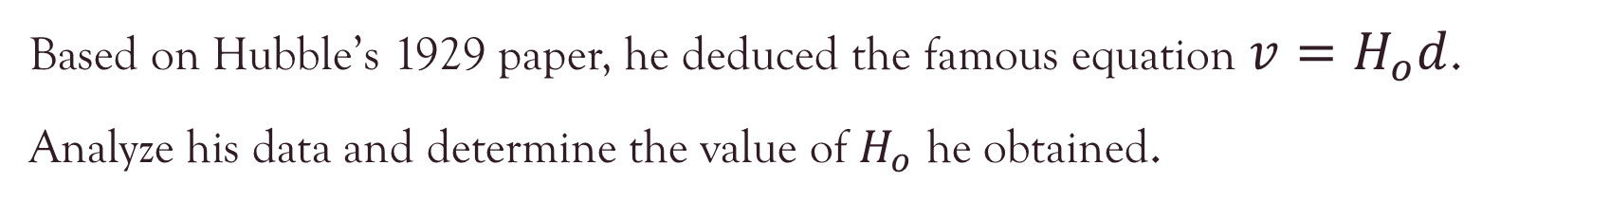
Q6
Based on Hubble’s 1929 paper, he deduced the famous equation $v=H_{o}d$.
Analyze his data and determine the value of $H_{o}$ he obtained.

Slide 21
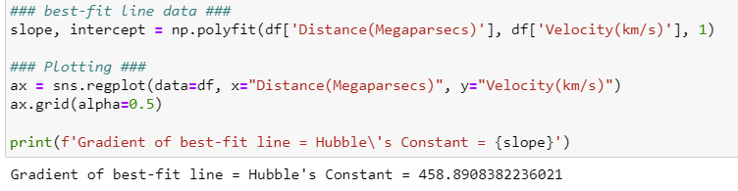
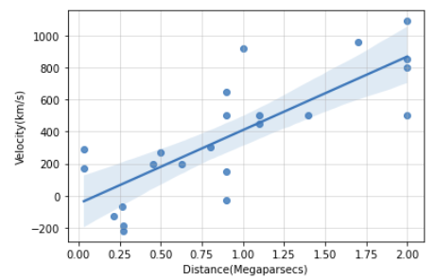
Q6
Using Python:

Slide 22
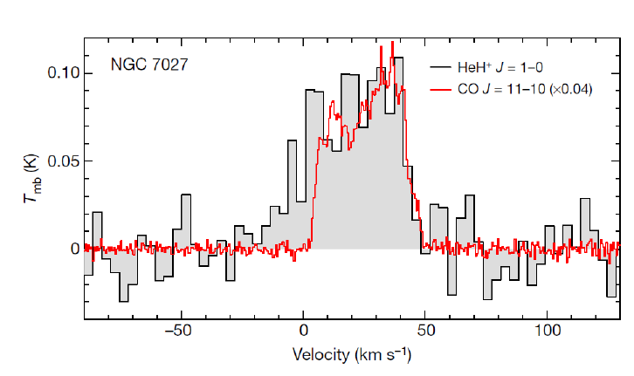
Q5
Study the figure given.
Note that the horizontal axis is given in terms of velocity. This velocity is the velocity of the source and is thus related to Doppler redshifts.
Spectra of HeH+ J = 1 → 0 and CO J = 11 → 10 rotational energy levels transitions in NGC 7027

Slide 23
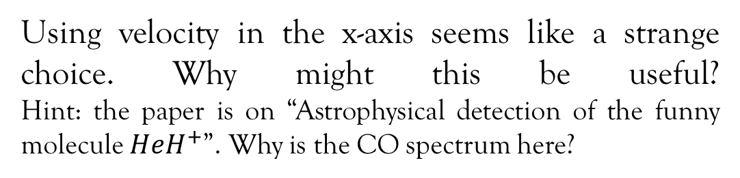
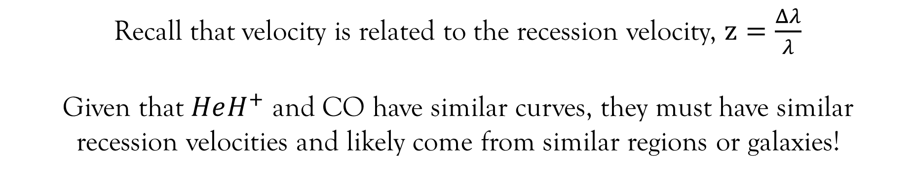
Q5a
Using velocity in the x-axis seems like a strange choice. Why might this be useful? Hint: the paper is on “Astrophysical detection of the funny molecule $HeH^{+}$”. Why is the CO spectrum here?
Recall that velocity is related to the recession velocity, $z=\frac{Δλ}{λ}$
Given that $HeH^{+}$ and CO have similar curves, they must have similar recession velocities and likely come from similar regions or galaxies!

Slide 24
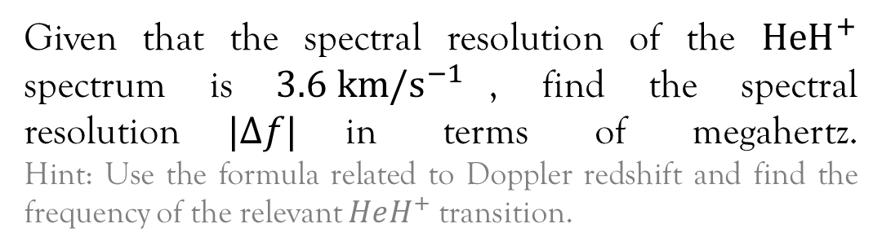

Q5b
Given that the spectral resolution of the $HeH^{+}$ spectrum is $3.6 {km/s}^{−1}$, find the spectral resolution$|Δf|$in terms of megahertz. Hint: Use the formula related to Doppler redshift and find the frequency of the relevant $HeH^{+}$transition.
$\frac{Δf}{f}=−\frac{v}{c}$ and $HeH^{+}$J = 1→0 transition is $2010 GHz$
$$\left|Δf\right|=2010×{10}^{9}\left(\frac{3600}{3×{10}^{8}}\right)=24.1 MHz$$

Slide 25

Questions?

